Slide 1
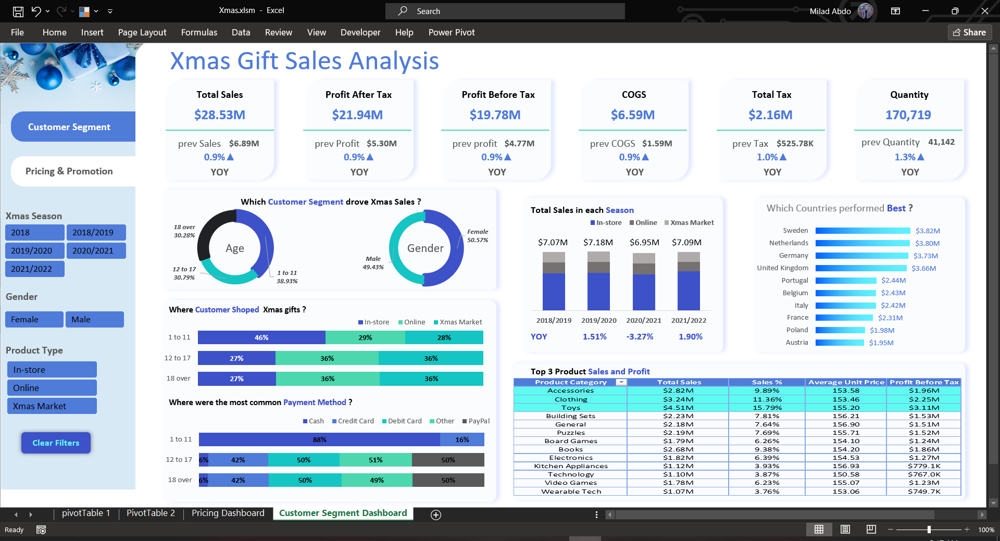

Slide 2
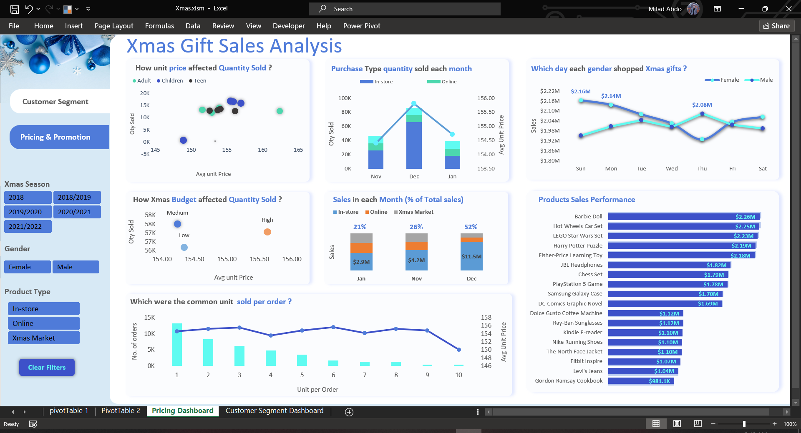

Slide 3
Xmas Sales Dashboard
I’ve just completed an in-depth analysis of product sales data, and I’m eager to share the insights and learnings from this project. Here are some highlights:
📊 Objectives:
Identify sales trends and patterns across different regions and time periods
Analyze factors influencing product performance
Provide actionable insights to optimize sales strategies

Slide 4
Tools Used
Excel
And Used a Macro Record for Clear filters
Power Query to connect with the data and transform it
Create Some Custom Columns ( Xmas Seasons Based on Nov, Dec 2018 and Jan 2019 and so on.. )
Create A Date Table
Remove Unused Columns from Table
Clean the data from blanks

Slide 5
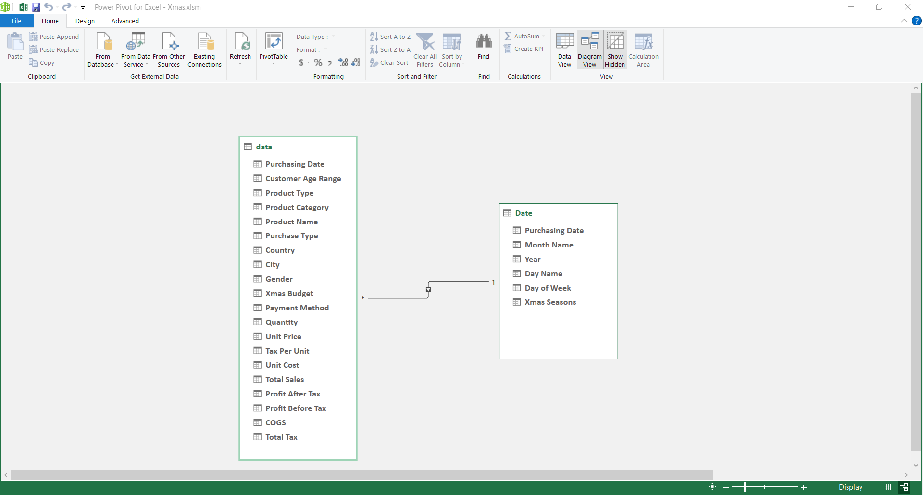
The Dataset diagram view and Relationships

Slide 6
Customer Segment Dashboard
KPI Comparison to Previous Year:
COGS, Sales, Quantity, Profit before and after tax Total Tax compared to the previous year (YOY Change)
Answering some of questions
1. Which Customer drove Xmas Sales ?
Total Sales based on Gender and age range -> ages 1-11 contributing 38.93% of total Christmas sales over the years.
2. Where customer shopped Xmas gifts ?
Sales based on three type of shopping channel (in store , online, Xmas Market) and Age Range -> In-store shopping was a prevalent choice.
3. Which were the most common payment method ?
Total Sales based on the payment method ( Cash , Credit , Debit , Other , PayPal) -> Cash was the
preferred payment method for Kid purchases,

Slide 7
4. Did covid affected Xmas Sales ?
Evaluating Sales performance on each Season and (YOY Change)
5. Which Countries Performed best ?
Sales of each country in The four seasons -> Sweden have the best Sales
6. Top 3 Product Category of Sales
We Have toys , clothing , accessories have the best sales in all seasons

Slide 9
Pricing and promotion Dashboard
Answering some of questions
1. How unit price affected quantity sold ?
higher prices, children's products lead in sales quantity
2. How Xmas budget affected quantity sold ?
The medium budget have the best quantity sold
3. How many quantity sold by Channel each month ?
December was the busiest month for Christmas gift shopping Especially in store shopping
3. Which Day each gender shopped Xmas gifts ?
Sunday have the best sales for female , Thursday for male

